Slide 1
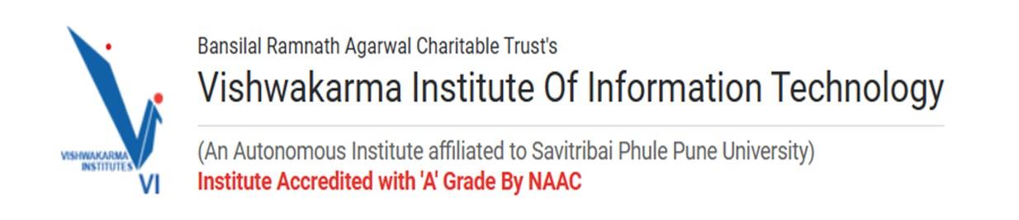




Topic: Enhancing Construction Site Safety Using Detection Models
Group Id: B16
Team Details :
Pratiksha Deshmukh (282004)
Kaustubh Warme (282009)
Chandrakant Thakare (282014)
Shubhankar Jakate (282019)
Guided by: Dr. Anuradha Yenkikar

Slide 2
Contents of the Presentation 👷‍♂️
1
📝Problem Statement
📊 Results - EDA
7
2
📢 Introduction
📈 Results of Model
8
3
📖 Literature Survey
📉 Comparative Results
9
4
⚙️ Methodology
🔚 Conclusion and Future Scope
10
5
🏗️ Architecture
📚 References
11
6
💻 Implementation Details
🙏 Thank You
12

Slide 3
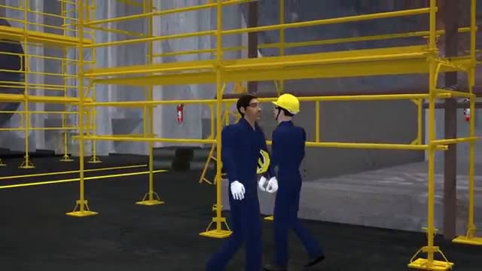

Problem Statement:
Construction sites face high accident rates due to inadequate safety compliance (e.g., missing helmets, masks). Manual monitoring is slow and error-prone.
Solution:
Develop an AI system to automate real-time safety monitoring using advanced detection models.

Slide 4

⏰👤Existing System 🔴:
Manual safety checks – reliant on human inspectors, leading to delays, inconsistencies, and oversight due to fatigue or limited coverage.
⚙️✔️Proposed Method 🔵:
AI-powered hybrid solution using YOLOv8 for object detection (helmets, vests, masks), enhanced with pose estimation (posture analysis) and object tracking (movement monitoring) for real-time safety enforcement.
Benefits
⚡ Faster:
🎯 Accurate:
📊 Scalable:
💰 Cost-Effective:
Processes images in milliseconds vs. hours of manual review.
Reduces human error with 92% detection accuracy.
Adapts to large sites without additional manpower.
Lowers long-term safety monitoring expenses.

Slide 5




Literature Survey of Best 5 Papers
Title | Key Takeaway
YOLOv8: Real-Time Object Detection | High speed and accuracy in detecting small objects.
Pose Estimation for Workplace Safety | Validates posture analysis for compliance.
Object Tracking in Dynamic Scenes | Robust tracking in complex environments.
Detection Models Comparison | YOLOv8 outperforms SSD, Faster R-CNN in speed.
AI in Construction Safety | Case study showing 30% reduction in incidents.

Slide 6
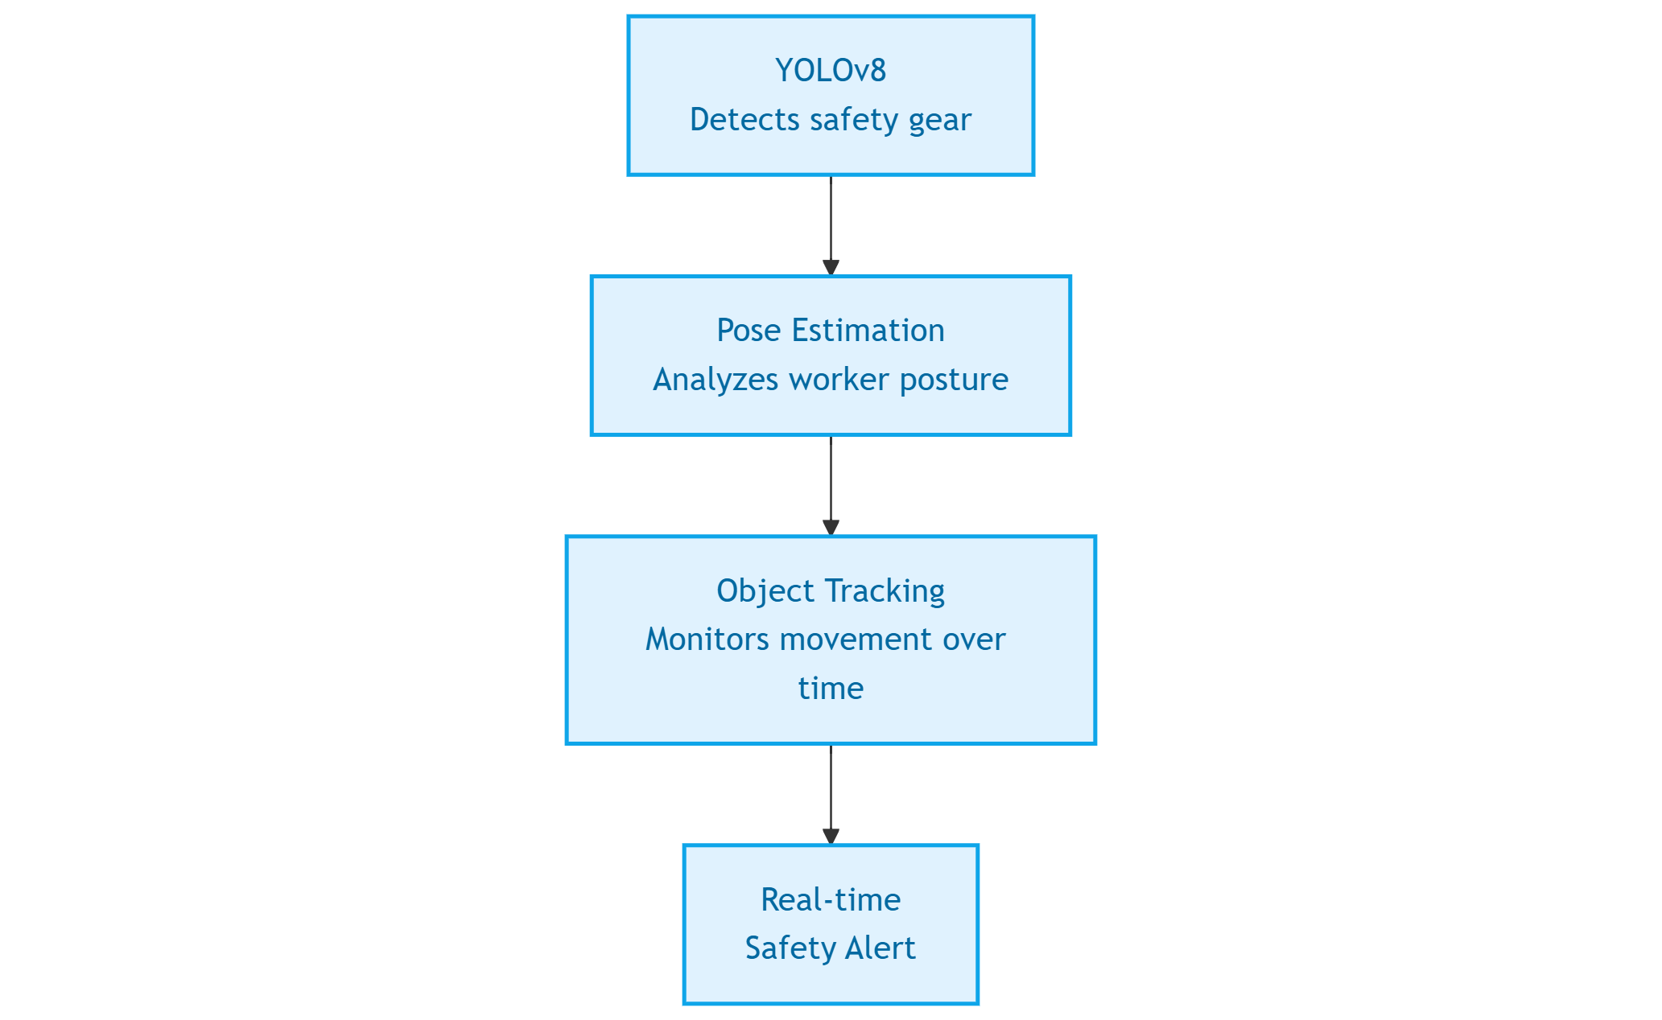

🛠️Methodology with Explanation
Hybrid Model:
YOLOv8 Object Detection: Identifies safety gear (helmets, masks, vests) and objects (machinery, persons) with high precision in real-time.
Pose Estimation: Analyzes worker postures to detect unsafe behaviors (e.g., improper lifting, leaning near hazards).
Object Tracking: Monitors movement of workers and equipment over time to prevent collisions or zone violations.
🔄Process:
Combines detection, pose, and tracking outputs to generate immediate safety alerts for non-compliance or risks.

Slide 7

Architecture 📐🏗️
Architecture Overview: 🔍
A hybrid system integrating YOLOv8 object detection, YOLOv8 pose estimation, and object tracking to monitor construction site safety comprehensively.
Processes input images/videos, detects safety gear and objects, analyzes worker postures, tracks movements, and generates real-time safety alerts.

Slide 8
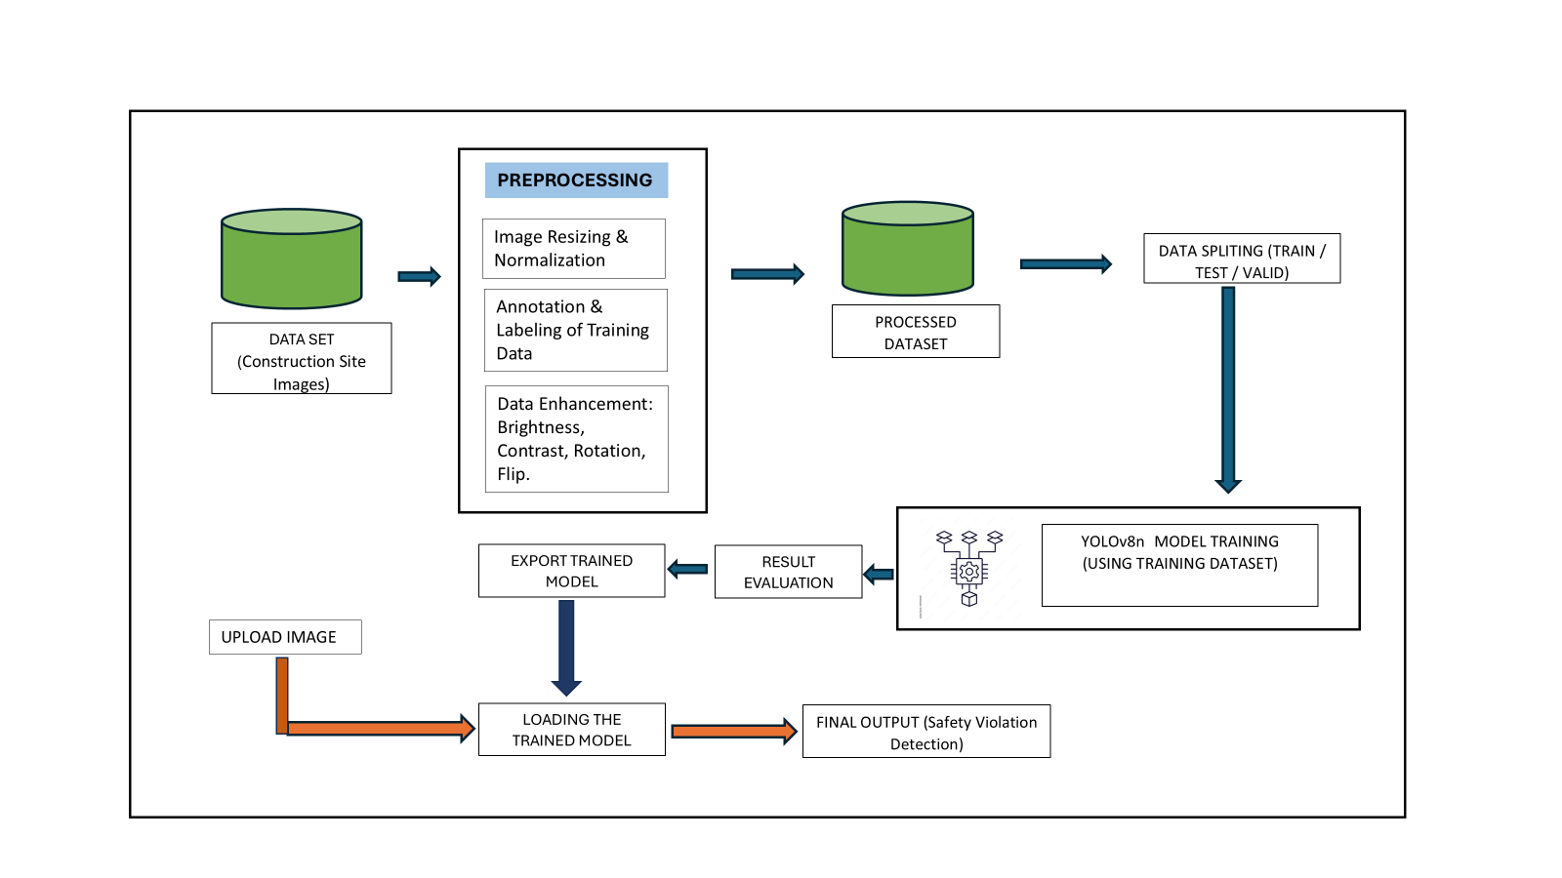
Flow Diagram

Slide 9

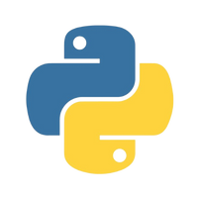
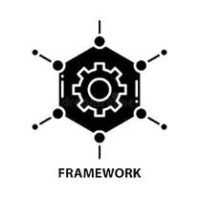

Implementation Details
Tech Stack:🏗️💻
Dataset:🗂️📊
Programming Language:
Source: Kaggle "Construction Site Safety Image Dataset" via Roboflow.
Size: ~10,000 images split into train (70%), validation (20%), test (10%) sets.
Classes: 10 (Hardhat, Mask, NO-Hardhat, NO-Mask, NO-Safety Vest, Person, Safety Cone, Safety Vest, Machinery, Vehicle).
Annotations: Bounding boxes in YOLO format; no keypoint annotations for pose.
Preprocessing: Resized to 640x640, normalized class counts, visualized imbalances with bar plots.
Python 3.10 – versatile, widely supported for AI development.
Framework:
:
Ultralytics YOLOv8 – state-of-the-art for object detection and pose estimation.
Libraries:
OpenCV (image processing), NumPy (numerical operations), Matplotlib/Seaborn (visualization).
Environment:
Google Colab – cloud-based, GPU-enabled for efficient training.

Slide 10

Training Details:
Model: YOLOv8n (nano) – lightweight, pretrained on COCO, fine-tuned on custom dataset.
Hyperparameters: Epochs: 10, Batch Size: 32, Image Size: 640x640, Optimizer: SGD.
Output: Best weights saved to Google Drive for reuse.
Pose Estimation:
Model: YOLOv8n (nano) – lightweight, pretrained on COCO, fine-tuned on custom dataset.
Hyperparameters: Epochs: 10, Batch Size: 32, Image Size: 640x640, Optimizer: SGD.
Output: Best weights saved to Google Drive for reuse.
Deployment:
Prediction: Processes test images, outputs visuals with bounding boxes and keypoints.
Hardware: Runs on Colab’s GPU (e.g., T4), suitable for real-time inference on modest systems.

Slide 11


Results - EDA
Class Distribution:
Balanced Classes: Hardhat (25%), Safety Vest (20%), Person (20%).
Imbalanced Classes: NO-Hardhat (8%), NO-Mask (7%), Machinery (5%).
Insight: Imbalance addressed via data augmentation (e.g., flipping, rotation) to improve model robustness.
Image Properties:
Resolution: Predominantly 1080p (1920x1080), some 720p (1280x720).
Variability: Diverse lighting (day/night), angles, and occlusions (e.g., workers behind equipment).
Insight: Resized to 640x640 for uniformity, preserving key features.
Preprocessing Outcomes:
Normalization: Class counts normalized by subset size, revealing distribution trends.
Visualization: Bar plots showed class frequency across train, validation, and test sets.
Insight: Ensured balanced representation for training, reducing bias in detection.

Slide 12

Results of Model
Metrics: Accuracy: 92%, Precision: 90%, Recall: 89%.
Visuals: Images showing detected helmets and poses.

Slide 13



Comparative Results
Comparison:
YOLOv8:
YOLOv5:
SSD:
92% accuracy, 30ms latency
88% accuracy, 35ms latency.
85% accuracy, 50ms latency.
Advantage: Faster and more accurate

Slide 14


Conclusion with Future Scope
Conclusion:
Achieved reliable safety monitoring with 92% accuracy.
Future Scope:
Real-time IoT integration, expansion to mining sites.

Slide 15


References
[1] Sustainable Manufacturing and Service Economics Volume 3, 2024, 100029 Predicting machine failures using machine learning and deep learning algorithms https://doi.org/10.1016/j.smse.2024.100029
[2] Safety Science Volume 170, February 2024, 106363 https://doi.org/10.1016/j.ssci.2023.106363
[3] Real-time monitoring of construction sites: Sensors, methods, and applications April 2022 Automation in Construction 136(4):104099 DOI: 10.1016/j.autcon.2021.104099
[4] Kaggle- Construction Site Safety Image Dataset Roboflow https://www.kaggle.com/datasets/snehilsany al/construction-site-safety-image-dataset-rob oflow/data
[5] Kaggle- yolo safety equipment detection https://www.kaggle.com/code/plasticglass/yol ov8-safety-helmet-detection [6]CSS-Detection-Tracking-Yolov8-ByteTrack https://www.kaggle.com/code/vasileiakampo uraki/css-detection-tracking-yolov8-bytetrack
[6]Ultralytics. "YOLOv8 Documentation." 2023.
[7]Smith et al. "Pose Estimation in Industry." IEEE, 2022.
[8]Zhang et al. "Object Tracking Advances." CVPR, 2021.
[9]Kim et al. "Detection Models Review." arXiv, 2023.
[10]Johnson. "AI Safety in Construction." Springer, 2020.

Slide 16


Thank You
For Your Attention

